Slide 1
Log File Analysis & Reporting System
Apache Log Parsing, Storage & Reporting System
Presented By : Shivani Charak

Slide 2
Project Overview
A command-line tool that processes Apache log files.
Parses relevant information and stores it in a MySQL database.
Generates analytical reports to understand web traffic patterns.
Designed as a data engineering simulation project.

Slide 3
Objectives
Automate log parsing and analysis - Reduce manual work by automatically processing Apache log files.
Store structured data from unstructured logs - Convert raw log data into a clean, organized format in a MySQL database
Enable report generation (e.g., top IPs, status codes) - Produce analytical reports such as top IP addresses, most requested URLs, and status code distributions.
Provide CLI and optional dashboard interface – Allow user to interact via command-line commands and optionally view visual dashboard for deeper insights.

Slide 4
Architecture
Parser: Extract IP, timestamp, method, status code, etc.
MySQL DB: Stores parsed records (tables via SQL script)
CLI Reports: Generate CSV or plots (matplotlib)
Optional: Streamlit dashboard for visualization
Input: Apache log file (access.log)

Slide 5
Flow Chart
Apache Log File (access.log)
│
Parser (Python + Regex)
│
MySQL Database (Structured Logs)
┌───────┴────────┐
CLI Reports Optional Dashboard (CSV/Plots) (Streamlit)

Slide 6
Technologies Used
Python (log parsing, CLI, reporting)
MySQL (data storage)
Matplotlib (visual reporting)
Streamlit (optional dashboard)
ConfigParser, argparse, os, re

Slide 7
Log Parsing Workflow
Read each line from log file
Regex pattern matches fields (IP, datetime, etc.)
Convert and clean fields
Insert structured data into MySQL tables

Slide 8
Database Schema
Table: logs
Columns: id, ip_address, datetime, method, url, status_code, user_agent
SQL: Defined in `create_tables.sql`

Slide 9
Reports Generated
Top 10 IP addresses
Status code distribution
Requests per day/hour
Most requested URLs

Slide 10
Sample Log File Format
127.0.0.1 - - [10/Oct/2023:13:55:36 +0000] "GET /index.html HTTP/1.1" 200 1043
Field Breakdown: IP | DateTime | Method | URL | Status | Size

Slide 11
Command-line Usage
python main.py process_logs <log_file_path>
python main.py generate_report top_ips
python main.py generate_report status_code_distribution

Slide 12
APIs & Libraries Used
argparse – Command-line parsing
configparser – Configuration handling
re – Regular expressions for log parsing
mysql.connector – MySQL database interaction
matplotlib.pyplot – Report plotting
streamlit – (Optional) Dashboard
os, sys, datetime – System & time handling

Slide 13
Optional Dashboard (Streamlit)
Visual interface for web traffic analysis
Run using: `streamlit run streamlit_dashboard.py`
Shows charts, filters, and metrics

Slide 14
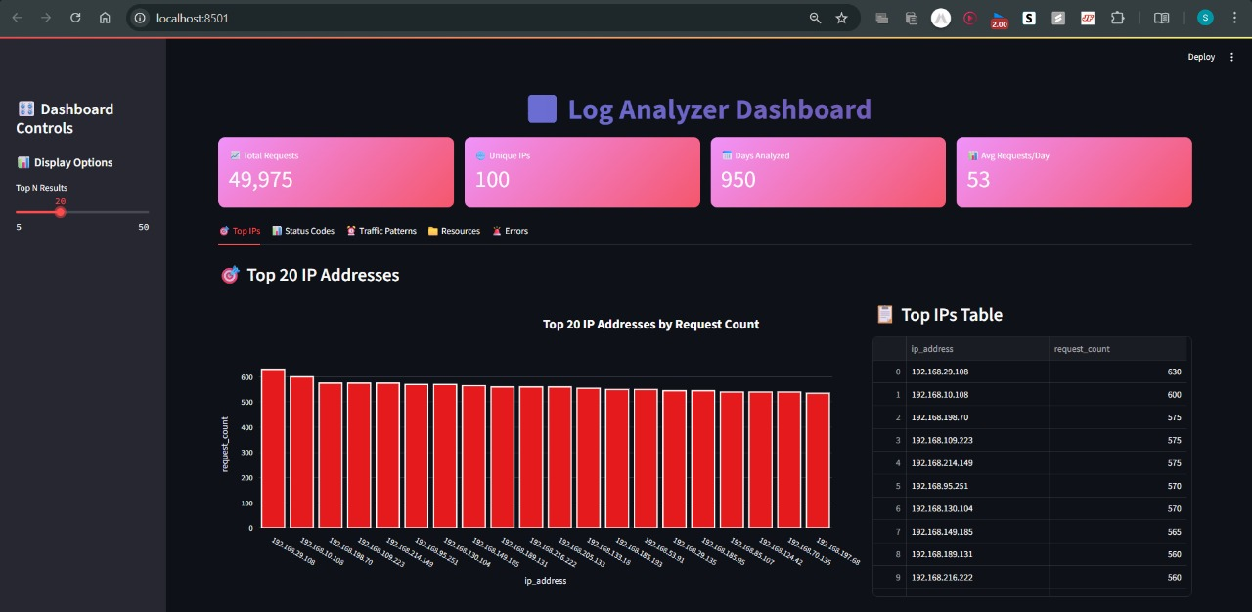

Slide 15
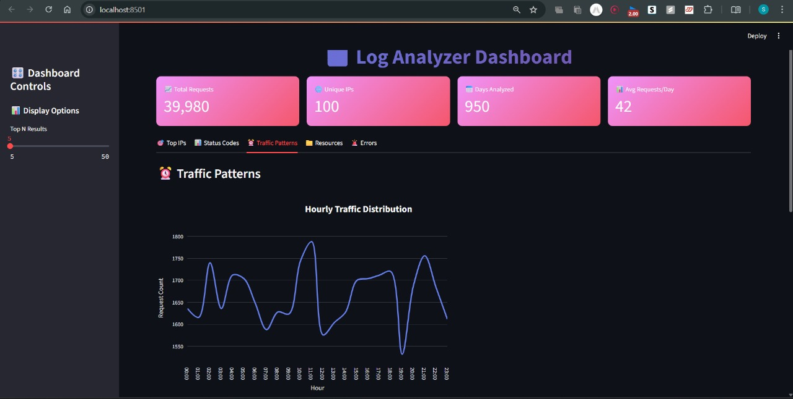

Slide 16
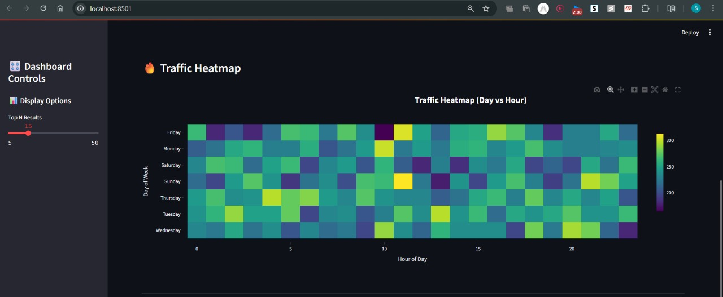

Slide 17
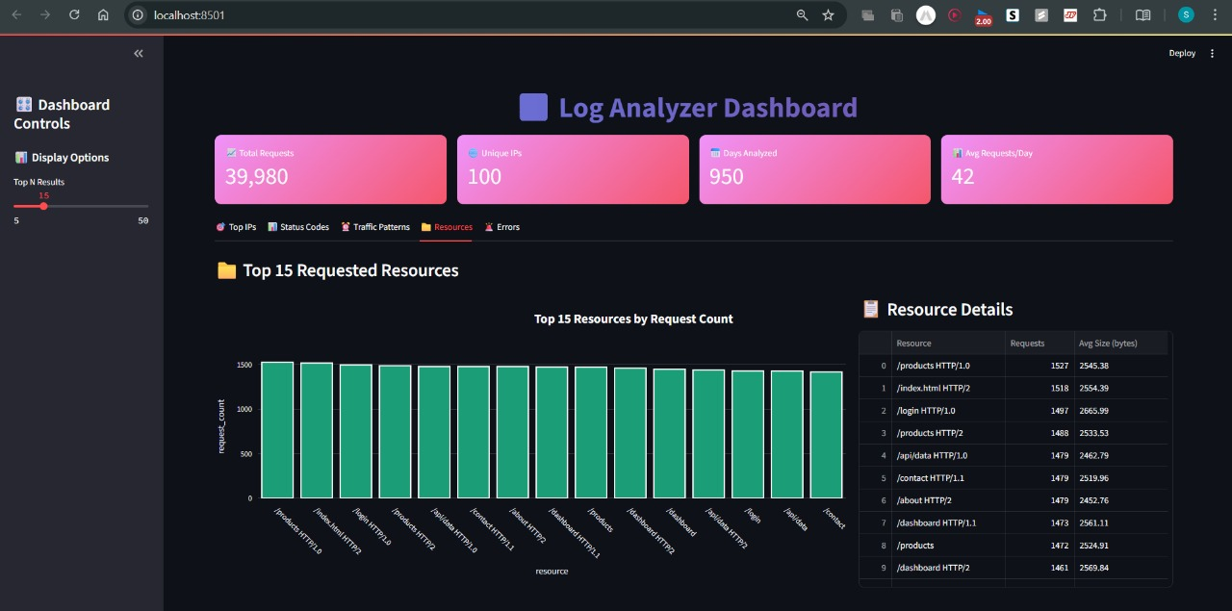

Slide 18
Conclusion
The Log File Analysis & Reporting System successfully automates the complete process of extracting, storing, and analyzing Apache server logs. By converting raw, unstructured log data into a structured format in MySQL, it enables quick and meaningful insights into web traffic patterns.
The system’s CLI interface ensures fast, scriptable operations, while the optional Streamlit dashboard provides interactive data visualization. Its modular design allows easy scalability — new report types, alert mechanisms, or additional data sources can be integrated without major code changes.
Overall, this project demonstrates the practical application of Python, MySQL, and data visualization tools in solving real-world data engineering problems, making it a valuable asset for both operational monitoring and strategic decision-making.

Slide 19


